Slide 1
Intro to C
Lecturer: Nadia Binte Asif

Slide 2
Programming Language
Computer Language
Low Level Language
No need of compiler or Interpreter
Machine Dependent → 0’s and 1’s → M/C language
Specific Processor-→ Set of Instructions → Assembly Language
High Level Language
Human Readable
Requires Compiler

Slide 3
Programming Language
Computer Language
High Level Language
Human Readable
Requires Compiler
Types: Object Oriented Language [Java, Python, C++] , Structured Programming Language [C, FORTRAN, Basic, Pascal], Natural Language
Mid Level Language
Between High and Low Level → Intermediate Lang.
User Friendly [ C, C++ ]

Slide 4
Programming language
How does programming language makes computer to do something?
Computers only understand binary
Writing code in High Level Lang → Compiler → M/C code
Source Code:
Executable Program:
Compile time
Runtime

Slide 5
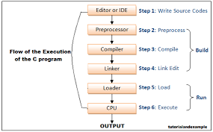
How C gets executed?
Preprocessing
Compiled → Assembly level code
Assembler → Object Code
Linker → Object code is linked with library functions→ .exe file
Loader → .exe file loaded into RAM

Slide 6
Facts about C
C was invented to write an operating system called UNIX.
C is a successor of B language which was introduced around the early 1970s.
Invented by Dennis Ritchie at Bell Labs
Compiler : GNU C/C++
https://www.tutorialspoint.com/cprogramming/c_environment_setup.htm

Slide 7
First program
#include <stdio.h>
int main() {
/* my first program in C */
printf("Hello, World! \n");
return 0;
}

Slide 8
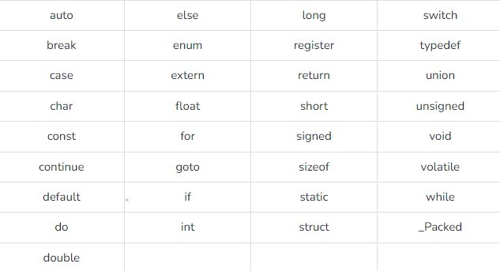
tokens
KEYWORDS
Keyword
Identifier
Constant
String Literal
Symbol
Reserved words in C
Can’t be used as variable name or constant

Slide 9
tokens
IDENTIFIERS
Keyword
Identifier
Constant
String Literal
Symbol
Defining variable, function or any user-defined item
Starts with a letter [ A-Z] or an underscore “_” followed by zero or more letters, underscores and digits [0-9]
Doesn’t allow punctuation characters: @, $, %
Case-sensitive: num2 and Num2 is diff
Jensen num11 abv num_1
_room j a2b3 productNum

Slide 10
software
CODEBLOCKS
https://www.wikihow.com/Download,-Install,-and-Use-Code::Blocks

